Slide 1
Transatlantic Rigid Sail
Avram, Sails

Slide 2
Requirements & Constraints
Mission Plan:
  Sea conditions
    Operating: Sea States 1-4
    Survivable: Sea State 5 (rough seas)
  Wind conditions
    Operating: Beafort 3-6 (~5-30 knots)
    Survivable: Gusts of up to 50 knots (Beafort 10)
Main limitations:
  Chord: Limited by drivetrain power/strength
  Span: Limited by rotational stability, ballast ratio
  Weight: Need to keep weight aloft as low as possible, with high strength
  Power draw: Needs to be entirely solar-powered
  Survivability is paramount

Slide 3
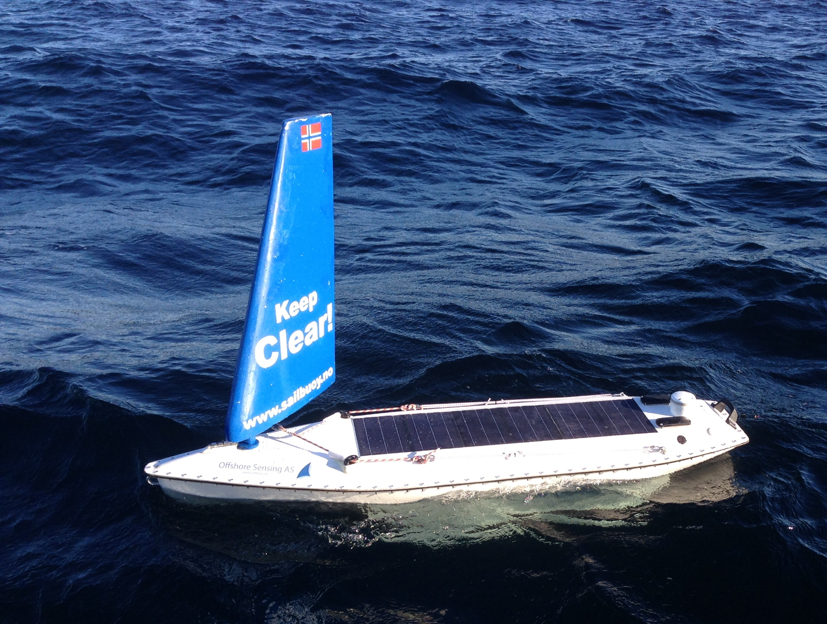
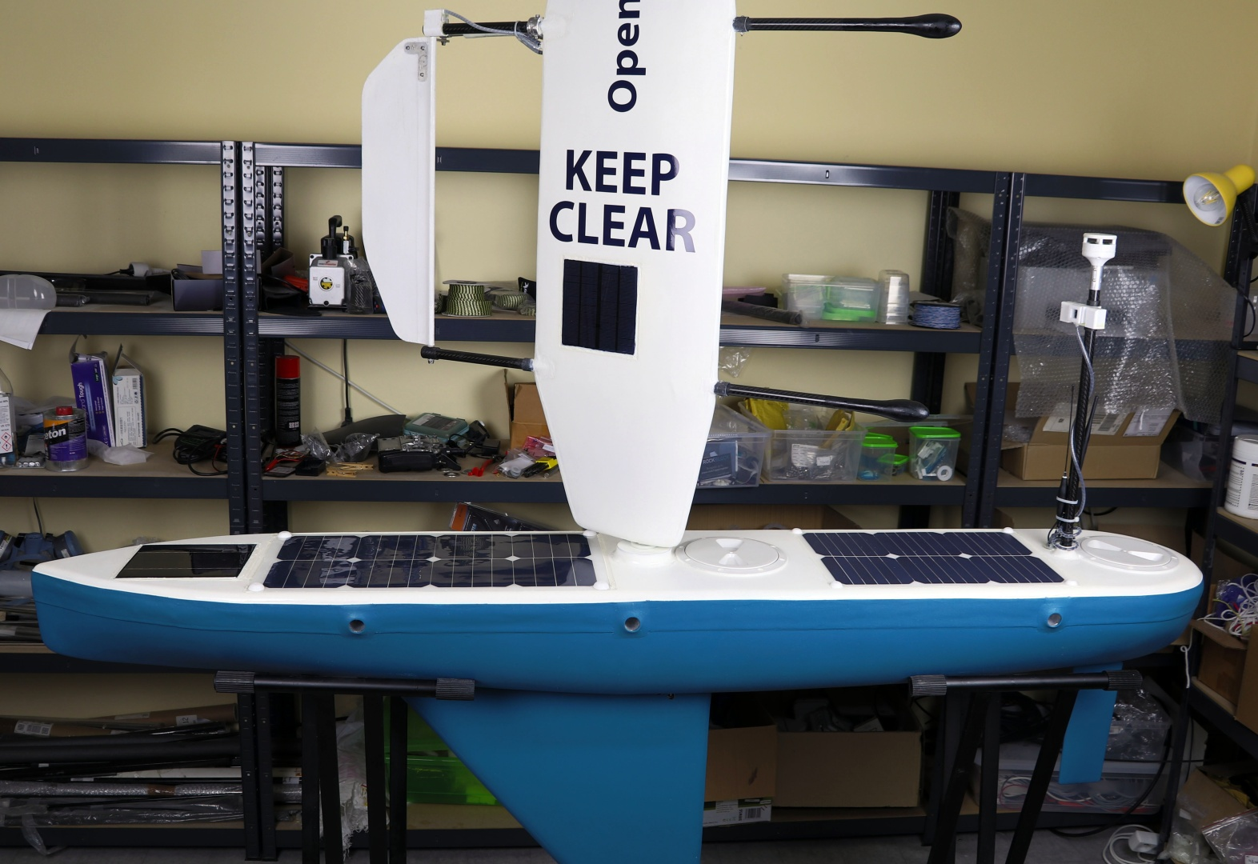
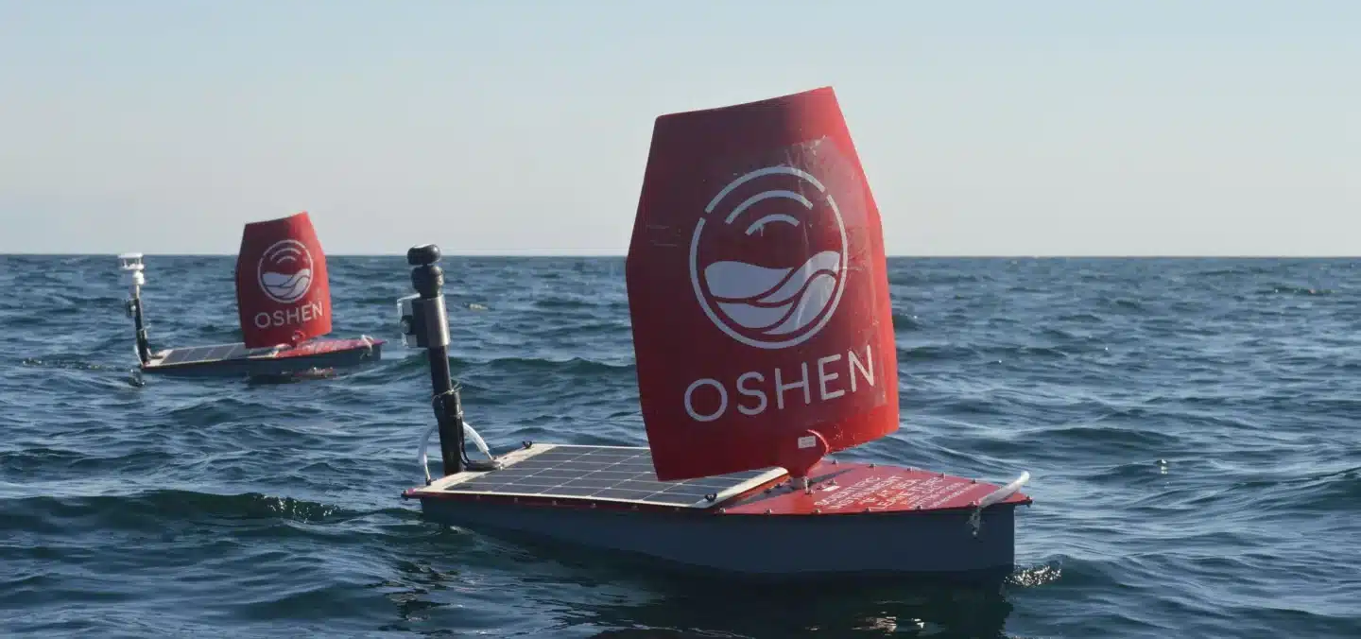
Previous Designs
Oshen C-Star | Offshore Sensing Sailbuoy | OpenTransat
Direct-driven, thin cambered plate airfoil | Direct-driven traditional airfoil | Free-spinning traditional airfoil with driven tail-sail for control

Slide 4
Considered Concepts
Design decisions
Decision | Chosen | Over | Why
Sail type | Rigid sail, turned by a motor in the hull | Wingsail, soft sail | All moving parts sealed inside the hull
Section | Curved (cambered) plate | Symmetric foil | Simple to build, can't flood, better in light air, better for downwind sailing
Storm hold | Self-locking worm gearbox | Slip clutch | Plate doesn't weathervane (next slide)
Size | Small, low aspect ratio | Bigger sail | Easier drivetrain design and better survivability, sacrificing speed/efficiency
Build | Glass/foam composite | Metal or plastic sheet on ribs | No fasteners to fatigue; repairable

Slide 5
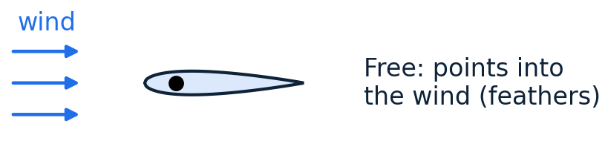
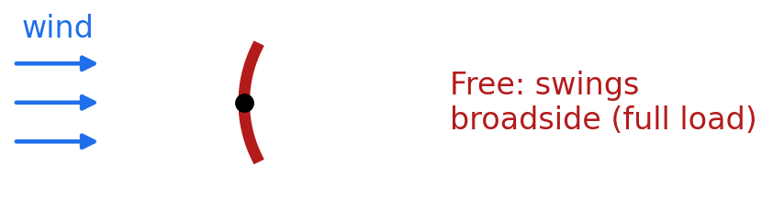
Aerofoil vs Cambered Plate
Symmetric Foil with Slip Clutch
Cambered Plate with Self-locking Clutch
+ Feathers itself if the drive lets go, reducing risk of capsize
− Requires continuous holding power
− Harder to build; weaker in light air
Optimized for upwind sailing
+ Simple to build, can't flood, better in light air
+ Draws little power when stationary
− Increases risk of capsize if drivetrain fails
-- More load on gearbox, requires self-locking worm gear
Optimized for downwind sailing

Slide 6
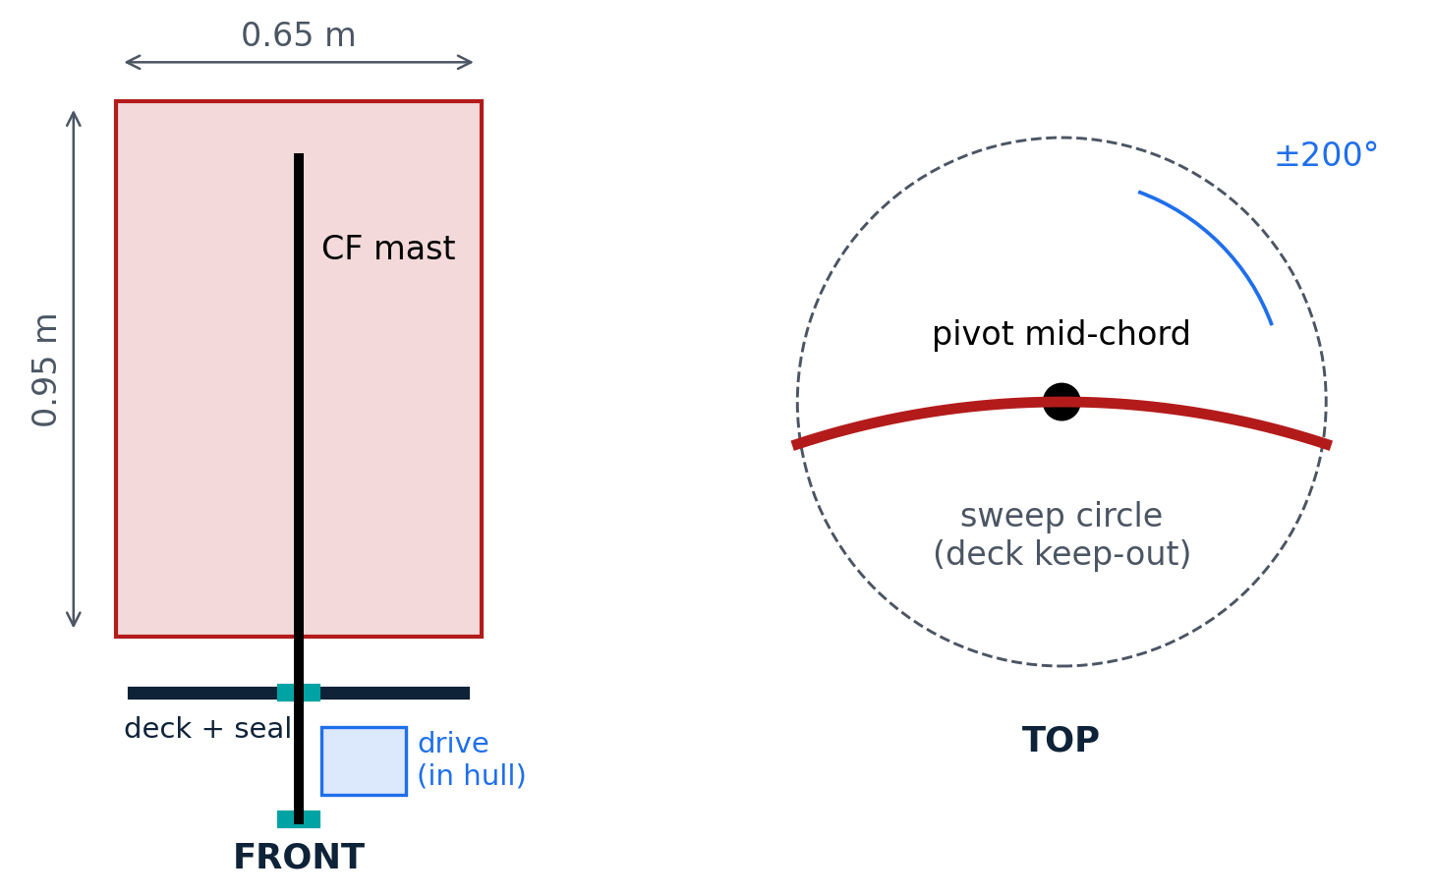
Proposed Design & Interfaces with other Systems
Mast: ~40mm carbon fiber tube
Sail: Thin composite layup with mast embedded internally
Mast is positioned at center of sail, with bearings at hull and deck
Deck bearing must be watertight

Slide 7
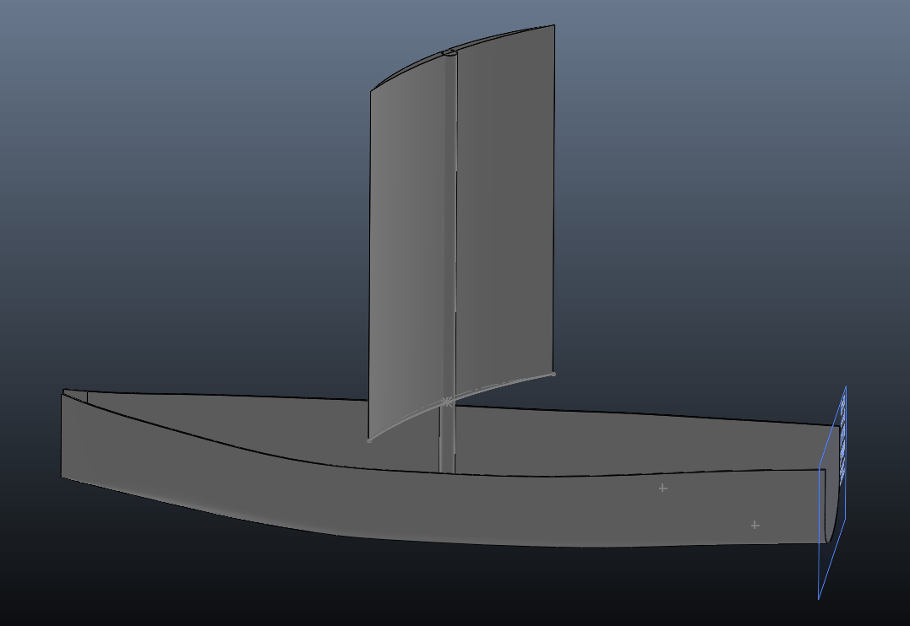
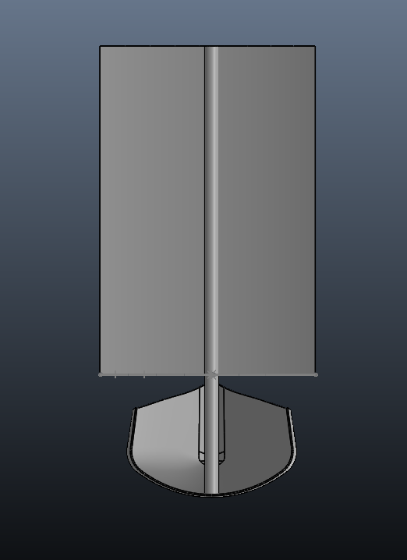
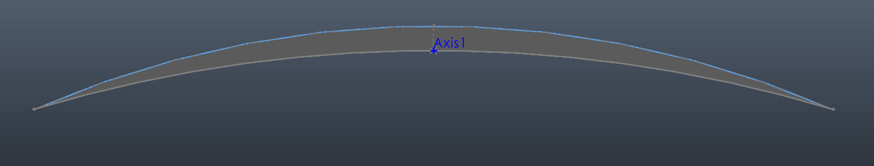
CAD

Slide 8
Engineering Analysis
Load cases
Structural checks
Case | q (Pa) | F (N) | M (N·m) | Sizes
Cruise 12 kn | 23 | 19 | 11 | Area, energy
27 kn powered | 118 | 95 | 55 | Heel, motor
50 kn feathered | 405 | 92 | 53 | Hold torque
50 kn broadside | 405 | 338 | 194 | Mast, bushings
Wave dunk 1.5 m/s | — | 171 | 159 | Check only
Part | Check | Value / limit | Margin
CF mast 42×2.5 | Bending σ | 101 / 400 MPa | 4.0×
CF mast | CE deflection (lim) | 3.5 mm | —
Bushings (0.226 m) | Deck / heel R (lim) | 1.20 / 0.86 kN | —
Plate faces | Face σ | 11 / 100 MPa | 9×
Plate core | Core shear | 26 / 350 kPa | 13×
Plate | Tip deflection (lim) | 2.2 / 5 mm | 2.3×
Takeaways:
Strength is not the limiting factor, priority is survivability and weight reduction
  Need to consider fatiguing over 100+ day voyage
Drivetrain and controls are the limiting factor

Slide 9
Testing & Validation
Planned tests
Test | Setup | Measures | Pass if | When
1. Plate CFD | 2D/3D sweep, AoA 0–180°, Re ~10⁵ | C_m, CP location | Hold ≲ 63 N·m | Oct (pre-CDR)
2. Sample panel + spine | 300×300 mm panel + spine section; weigh, 3-pt bend, impact | Mass, stiffness | Mass within 20 % of est. | Oct (pre-CDR)
3. Torque bench test | Plate on mast + torque arm / load cell at known airspeed | Torque vs angle | Within ~20 % of CFD | Nov
4. Gearbox static hold | Lever arm + weights to 94 N·m | Slip, creep, back-drive | Self-locks, no creep | After gearbox finalized
5. Mast seal + bushings | Mast stub through deck plug, submerged, ±200° cycles | Leaks, wear, friction | Dry inside, low wear | Dec
6. Lake test | Full rig on hull | Heading hold, heel, helm, power | Tracks downwind unaided | Spring
Need input: how to get a known airspeed for test 3 (fan, car-top rig, or wind tunnel access?)

Slide 10
Manufacturing Plan & Budget
Build plan
Budget (rough estimate)
CNC inner and outer molds from foam, treat and sand
Fiberglass-resin vacuum layup on each half
Bond halves to mast and seal edges with fiberglass strips
Fill with expanding foam for buoyancy
Paint and treat
Note: Can also consider a pre-made curved plate (e.g. plexiglass), but is likely heavier and less efficient than custom cambered plate
Item | Qty | Est. ($)
E-glass 200 g/m² | ~4 m² | 40
Laminating epoxy + fillers | ~2 kg | 120
PVC foam H60, 10 mm | 1 sheet | 70
Bagging consumables + former | 1 set | 120
CF tube 42 × 2.5 mm | 1.4 m | 180
Worm gearbox | 1 | 120
Geared motor + abs. encoder | 1 + 1 | 90
Bushings, lip seal, sleeve | 2 + 1 + 1 | 90
Fasteners, end stops, paint | — | 60
Test articles | — | 80
Total |  | ~970

Slide 11
Risks & Open Questions
Anything at all
Risks
  Drivetrain failure
    The drivetrain is the limiting factor in the survivability, especially in high winds
    Mechanical failure would result in loss of control
  Power draw
    Direct drive requires high torque
    Need to choose a lightweight and efficient motor for the task
Open Questions
  Manufacturing
    Custom composite layup vs. bent plate
    Whether to embed mast in sail or attach to side
  Design
    Specific airfoil selection
    Motor and drivetrain choice and feasibility

